Slide 1



Engage
Parent Newsletter

Slide 2

About Us
myHappymind is an award winning, NHS backed whole school and nursery curriculum. It teaches children preventative habits that support positive mental health, resilience and self esteem.
Taught to every child in a school from Early Years through to Year 6, myHappymind is delivered via an innovative technology platform making learning easy and fun.
All of the concepts we teach are based in science and research and grounded in Neuroscience and positive psychology.
We are passionate about supporting teacher wellbeing too and so all schools using the programme have access to a teacher wellbeing programme.
We are also proud to support parents by providing them with a free app to continue the learning at home.

Slide 3

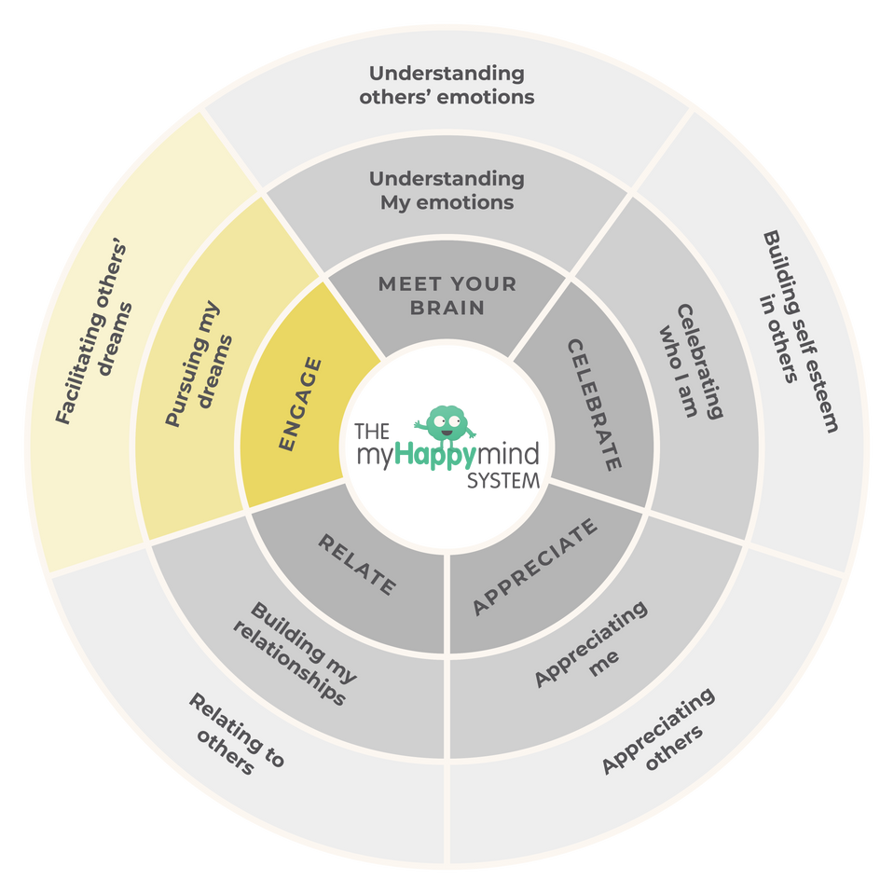
Engage
We have just come to the end of the last module - ‘Engage’ in the myHappymind programme.
We have learnt:
  Why it is important to have goals that we are passionate about.
  How to set our own goals.
  That when we feel good, we do good.
2

Slide 4
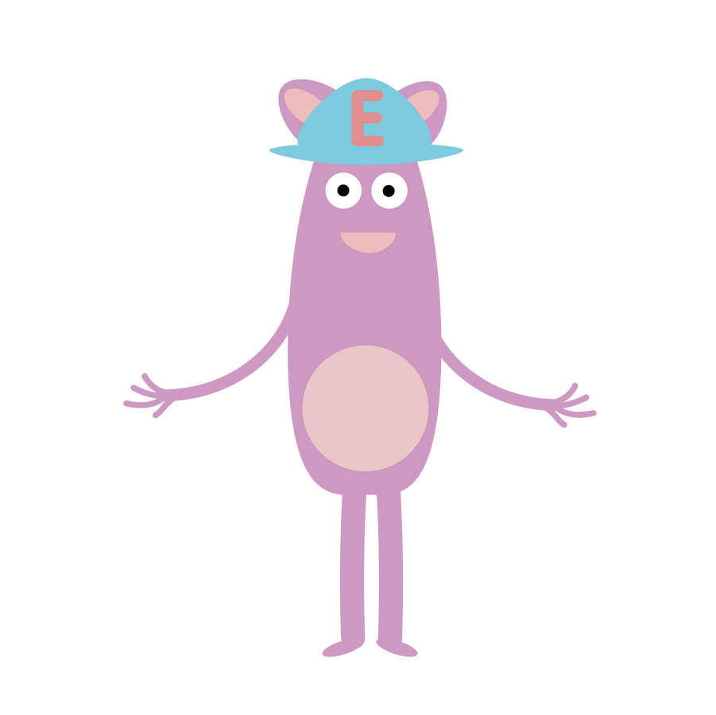
Engage
Why not ask your children to tell you what they have learnt?
Here are some questions to help you:
What is a Big Dream Goal and what is yours?
What are 3 steps to set a goal?
Do setting goals help you to feel good?
3

Slide 5

Support your child at home
Log onto the parent app for more information about the Engage module and how you can support your child at home.
There are lots of activites you can do together including listening to the story and song, plus much more.
There is a whole Kid’s Zone for your child to enjoy with interactive games. As well as resources for grown-ups too.
myHappymind for Parents
Educate yourself
Learn all about what your children are learning in school
Exclusively for parents with children at a myHappymind School or Nursery.
To access the materials just go to https://myhappymind.org/parent-resources and enter your name, email and authentication code.
(Please contact your school for your authentication code.)
4

Slide 6
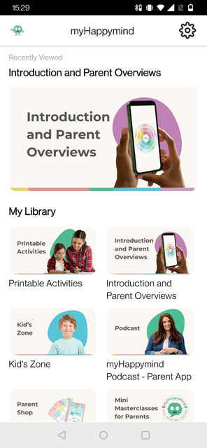
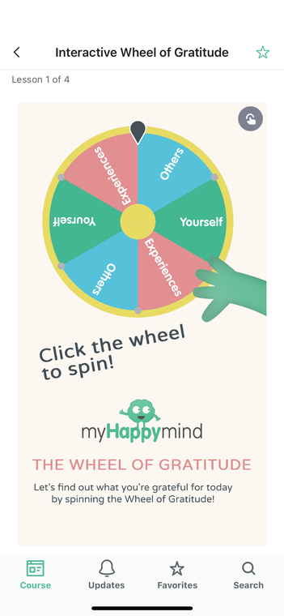
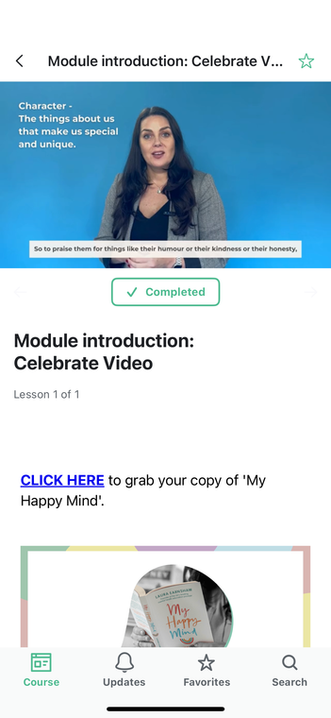


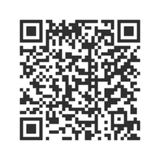
Support your child at home
Download
your FREE
Parent App now!
5

Slide 7
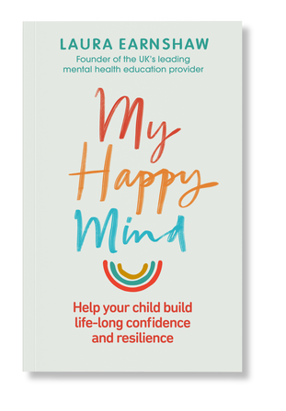
Want to learn more
about the science
of happiness?
This is the last module in the myHappymind programme. We have really enjoyed learning in school and we hope you have enjoyed continuing the learning at home with your child.
MY HAPPY MIND
BY LAURA EARNSHAW
My Happy Mind is the first book by our founder Laura Earnshaw. The book reveals all science-backed secrets used in our curriculum to empower ad educate parents - whether your child is struggling already, or you’re interested in future-proofing their mental health, there’s something in here for everyone.
Click here to learn more
6
1

Slide 8
Engage in action
7

Slide 9







Want to hear more
about myHappymind?
Want to share a picture of your myHappymind experience as a parent? We’d love for you to join us over on our social media channels!
myHappymind.org
@myHappymind
@_myHappymind
@myHappymind

